Slide 1

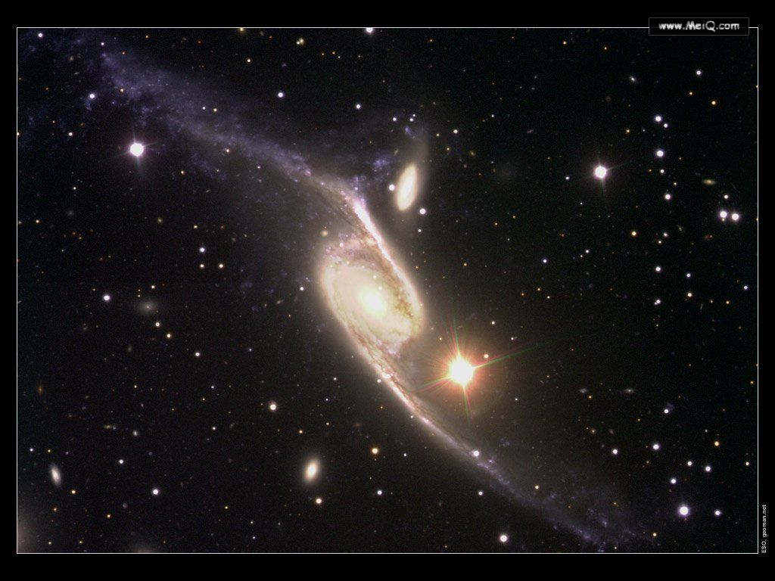

Module 5
The Conquest of the Universe

Slide 2
Listening and Speaking
First-listening
1
 | Joan | Mark
1 | Y | N
2 | N | Y
3 | Y | Y
4 | Y | N
5 | Y | N

Slide 3
1.What is Joan’s job?
A science fiction writer.
2.Which scientific theory does Mark speak about?
The speed of light.
2

Slide 4
3.Which problems on the Earth does Joan speak about?
Fighting poverty and disease.
4.Why would a trip in space be useful for Joan?
It would give her ideas for a book.
5. In which two place can Mark find peace and quiet?
In space and in the English countryside.

Slide 5
Second-listening
 | Mark | Joan
Infor-mation | a scientist working in ____________ | a __________ writer
Q1: Will people ever ______the Moon? | Yes. There will be a ________ _______ ________ where scientists and their _______ will go and live. | No. The Moon not _____ a _________ environment, its information can be _______ by computers ___________ there.
science fiction
astrophysics
permanent
being
research centre
hospitable
live on
families
gathered
to be set up

Slide 6
Q2: Should we ______ all that money ___ ______ ________? | Yes. Because ____ ____ ____ ___ from space research will help _________ search for the _____ of everything which will explain the ____ ____ ____ | No. It’s more _________ to spend that much money on problems like _______ _______ and disease on Earth.
what we find
necessary
out
spend
physicists’
fighting
on
theory
poverty
space
research
laws of nature.

Slide 7
Statistically
Q3: Is there ____ on other ______? | Yes. __________, it’s highly probable that ____ __ _____ that may not be anything like life as we know it ____ in _____ _____ | Yes. There must be _________ planets like our Earth out there, ____ _____ there exist some kind of forms of life.
life
millions of
forms of life
planets
on
which
exist
outer
space.

Slide 8
Q4: There ____ forms of life, will people be traveling to ____ ______ _____ them? | No. The fact ____ we cannot travel faster than light means that it will take ________ _________ to reach those planets. But it’s likely that we can ____________ in other ways. | Yes. It’s probable that people will be able to ____________ to reach the planet. And the _________ of _____________ writers has often pointed the way to future.
that
being
take short cuts
more than
a lifetime
imagination
make
contact
science fiction
with
communicate

Slide 9
Q5: Would you ____ ____ ____ pay for a holiday in space? | ___. Although the ____ and quiet is quite ________, it’s just a bit _______ in case things ____ ____ in space. | Yes. The trip will definitely _____ me _______ ___ write things.
No
peace
be
attractive
prepared to
give
scaring
inspiration
went
wrong
to

Slide 10
Everyday English
（1） a
（2） b
（3） a
（4） b

Slide 11
Exercise
（1）You may do anything as you like, but _________________, you’ll regret.
（2）Tom has presented his opinion. ______________?
（3）If you thought of taking _________ in learning English, that would be a bad idea.
（4）Professor Li gave us much valuable advice, which is ______________ for all of us.
at the end of the day
How about you
short cuts
food for thought

